Slide 1







Manufacturing Productivity
Analyzing factory efficiency.

Slide 2







Our Team
Nermine Elsayed
Hanan Abdulrazeq
Eman Maher
Sara Farouk

Slide 3

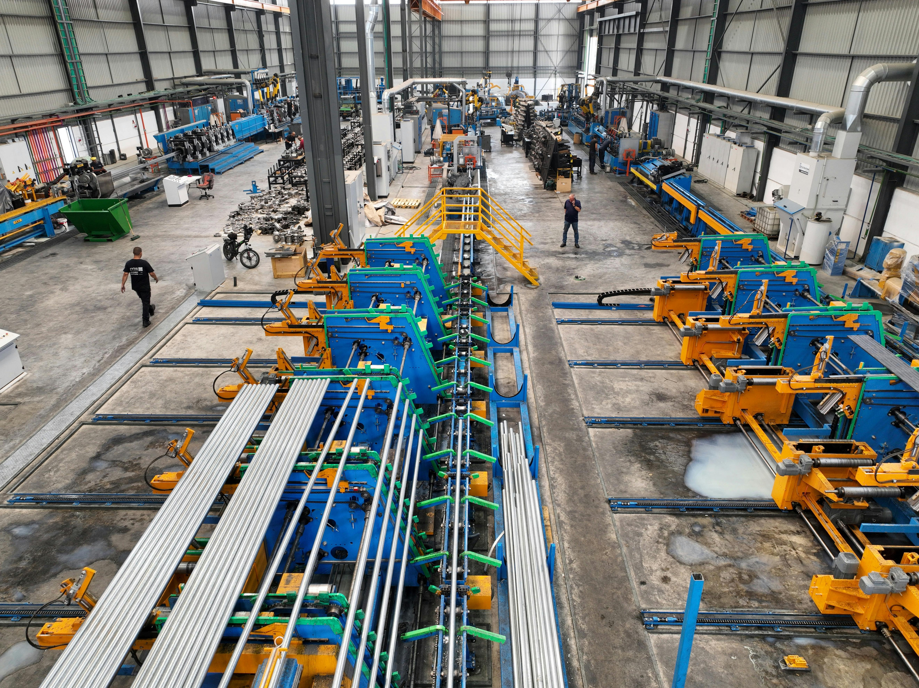


Executive Summary
Manufacturing Downtime Analysis
Insights - Forecasting - Productivity

Slide 4

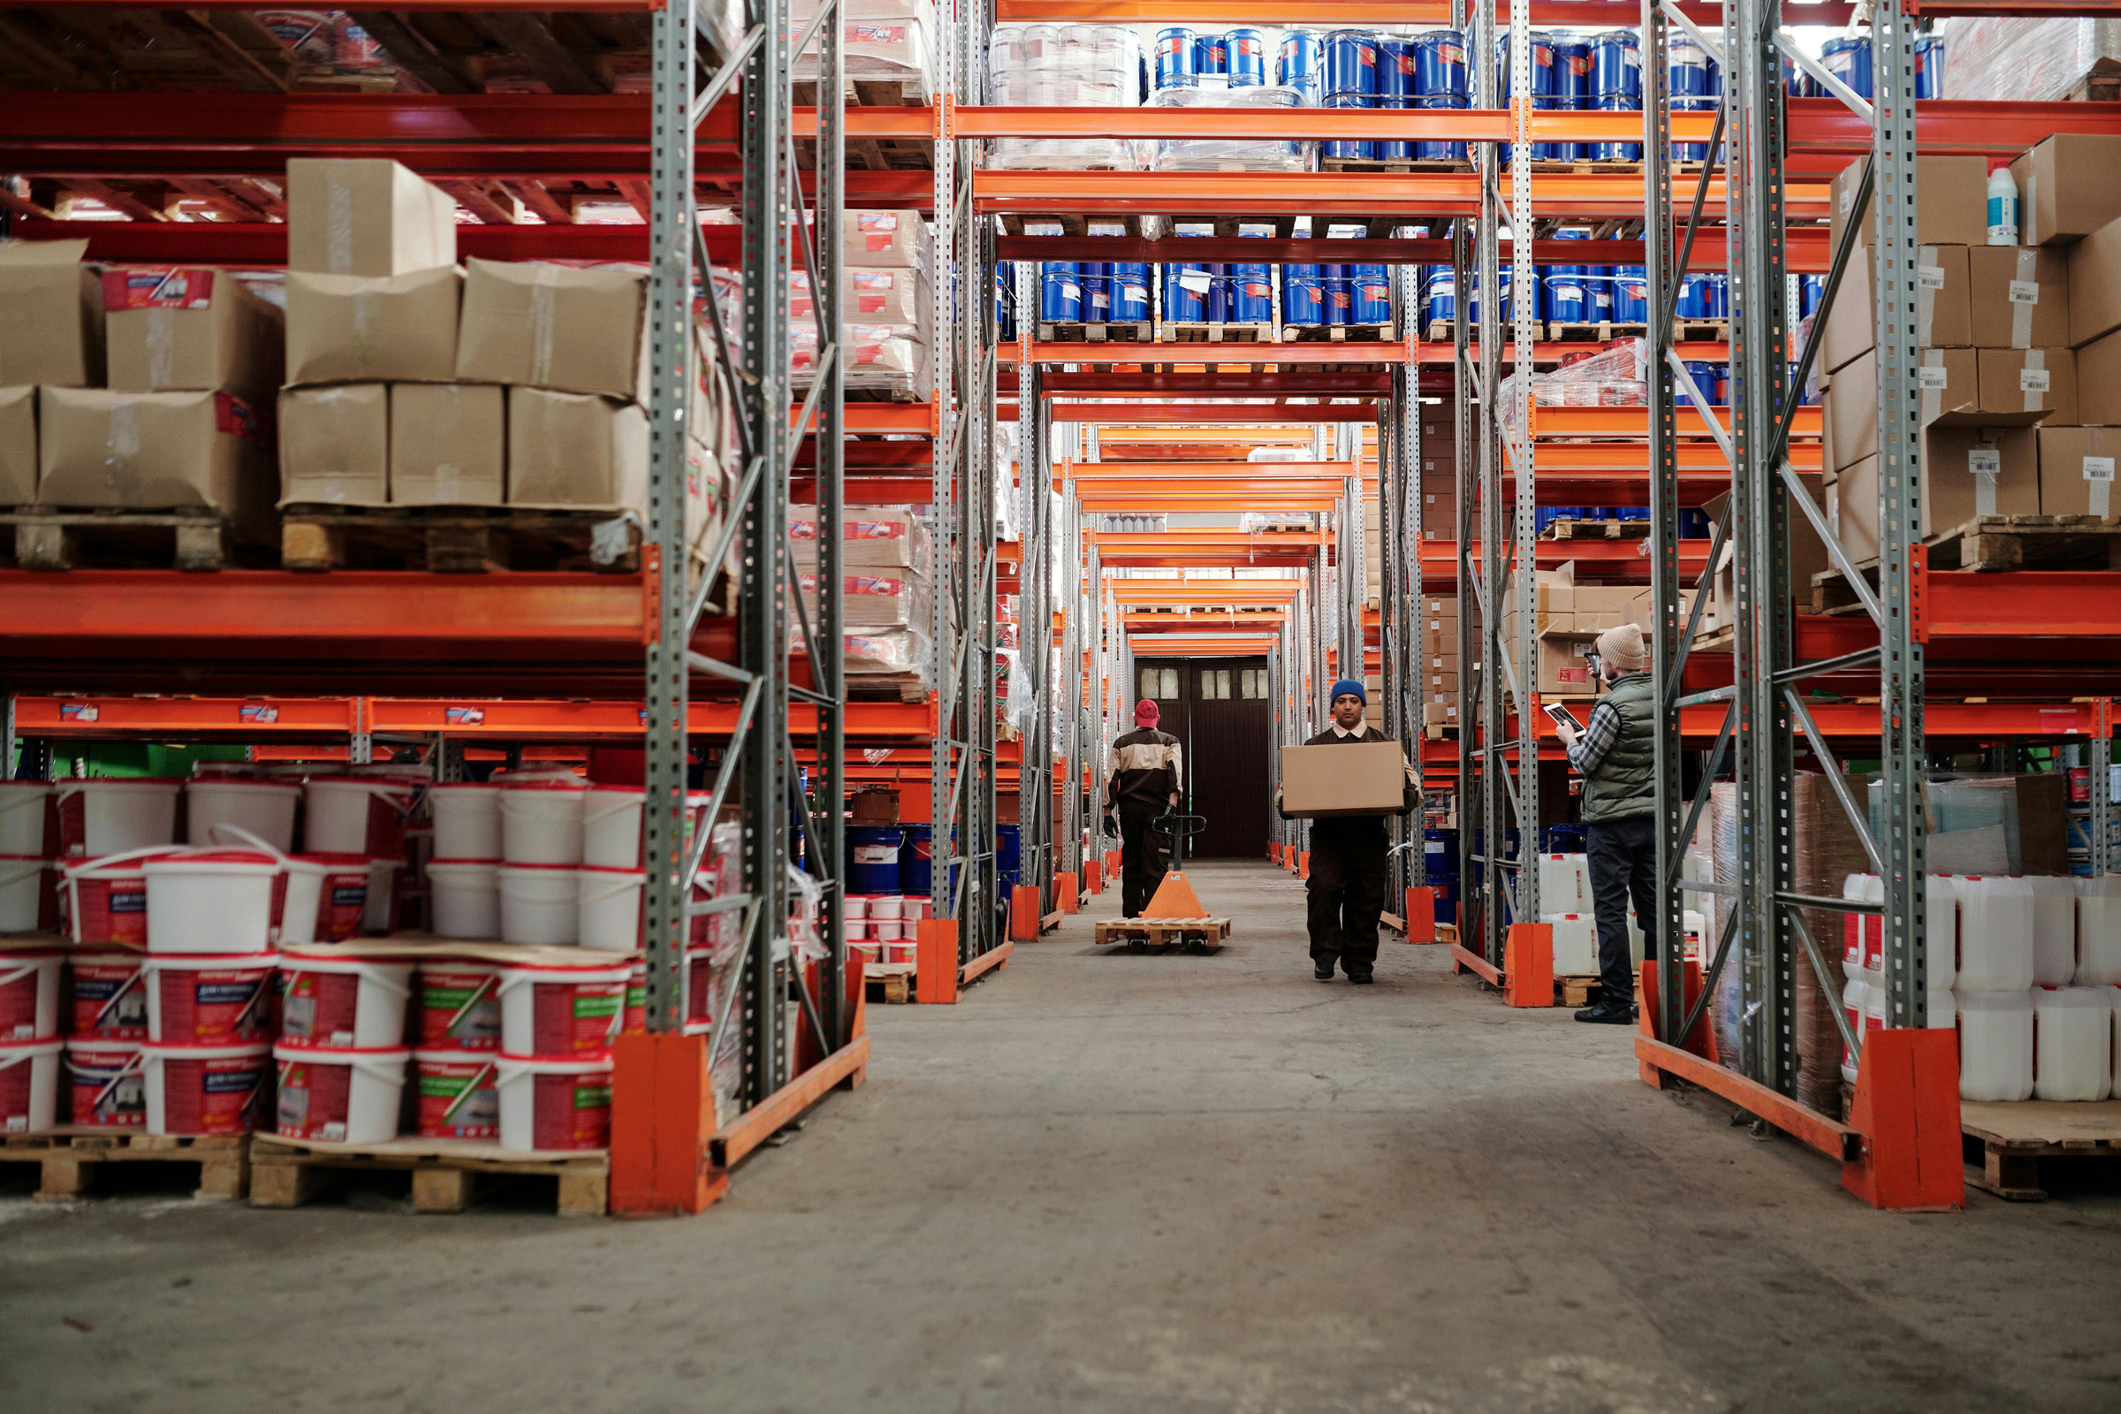

Introduction
Manufacturing downtime is a recurring issue that disrupts the production flow and decreases overall efficiency. When a production line stops, the factory loses time, output, and productivity. Our data includes detailed records of downtime events, production lines, and daily batches produced. Understanding these patterns is essential to identify the main causes of disruptions and improve the factory’s performance.

Slide 5




Methodology
We performed data cleaning using Python to fix missing values, removing errors, and making sure all information was organized and ready for analysis.
We calculated the main KPIs and performance metrics using Excel to understand production behavior and downtime impact.
We created an interactive dashboard using Power BI to visualize downtime patterns, operator performance, and daily batch output.
Finally, we applied predictive models to estimate next-day downtime and forecast expected production batches.

Slide 6

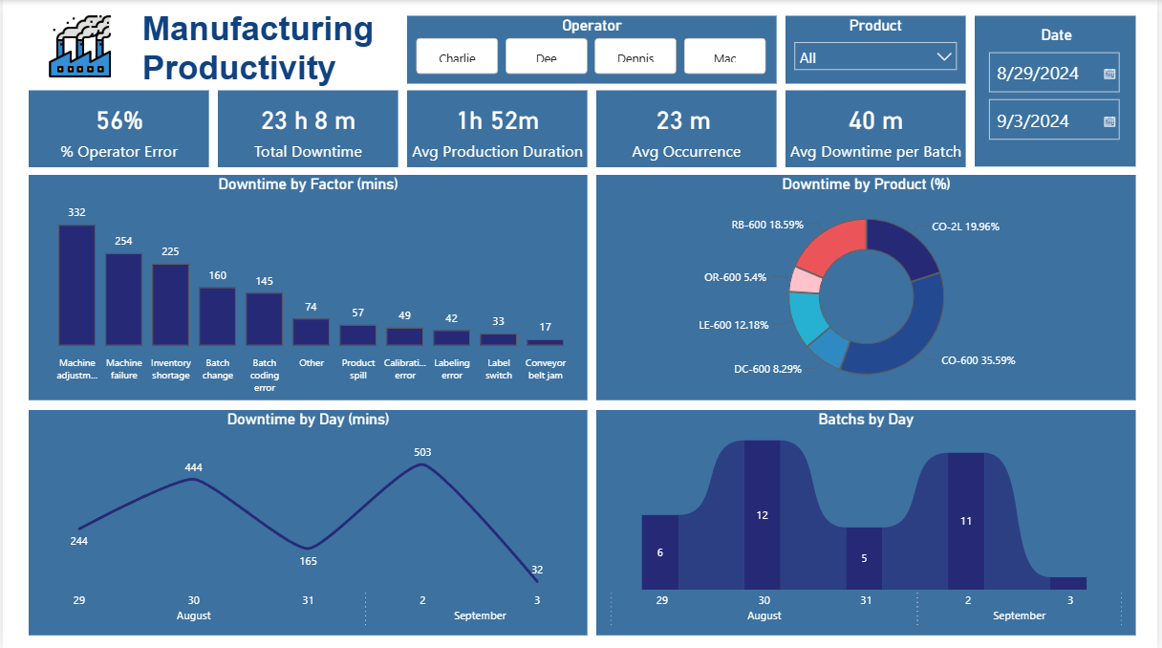
Results

Slide 7
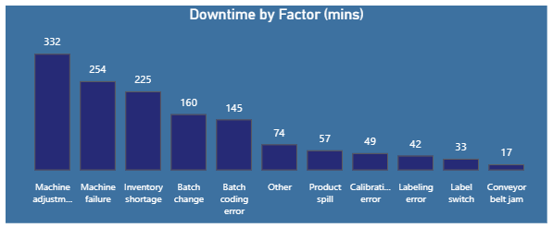

Total Downtime by Factor
This chart shows the main factors causing production downtime, with machine adjustment and machine failure being the highest contributors. Other factors like inventory shortage and batch change also add to the total downtime but their impact is less significant.

Slide 8
Results

Slide 9
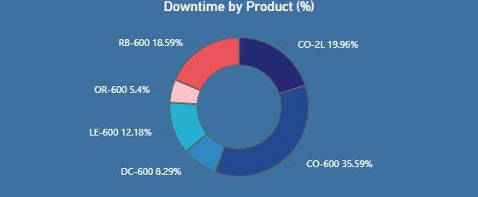
Downtime by Product
This chart shows downtime distribution by product, with CO-600 accounting for the largest share followed by CO-2L and RB-600.
Products like OR-600 and DC-600 contribute the least to overall downtime.

Slide 10
Results

Slide 11
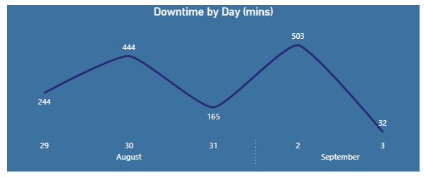
Downtime by Day
This chart shows daily downtime, starting at 244 minutes and peaking at 503 minutes before dropping sharply to 32 minutes.
Overall, downtime fluctuates significantly across the displayed days.

Slide 12
Results

Slide 13
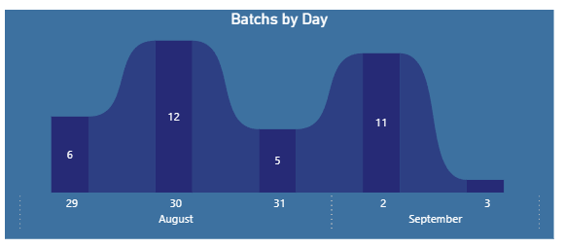
Batches by Day
This chart shows how many batches were processed each day from August 29 to September 3. Activity peaked on August 30 and September 2, while September 3 had almost no batches.

Slide 14

Conclusion
Operator errors are the main source of downtime, indicating process instability.
Total downtime (23h) reflects significant productivity loss.
Frequent interruptions show a system-wide performance issue.
Machine failures remain a key technical bottleneck.
CO-600 is the most affected product, creating concentrated inefficiency.
Large daily fluctuations reduce consistency and predictability.

Slide 15


Recommendations
Eliminate operator-related errors by enforcing strict training, clear SOPs, and continuous performance monitoring.
Adopt a preventive maintenance strategy to reduce machine failures and ensure consistent line availability.
Stabilize the production workflow through standardized processes, better scheduling, and tighter control over daily operations.
Prioritize optimization of the CO-600 line, as it creates the largest productivity loss, requiring focused root-cause analysis and corrective action.

Slide 16
Thank You
for Listening.

